Slide 1
Predictive maintenance of industrial machinery
CAPSTONE PROJECT
Presented By:
Student Name - Siddharth Tewari
College Name - University of Lucknow
Department – Computer Science and
Engineering (Artificial Intelligence)

Slide 2
OUTLINE
Problem Statement (Should not include solution)
Proposed System/Solution
System Development Approach (Technology Used)
Algorithm & Deployment
Result (Output Image)
Conclusion
Future Scope
References

Slide 3
Problem Statement
Develop a predictive maintenance model for a fleet of industrial machines to anticipate failures before they occur. This project will involve analyzing sensor data from machinery to identify patterns that precede a failure. The goal is to create a classification model that can predict the type of failure (e.g., tool wear, heat dissipation, power failure) based on real-time operational data. This will enable proactive maintenance, reducing downtime and operational costs.

Slide 4
Proposed Solution
Develop a Machine Learning model that can predict the type of failure using the dataset provided. The model will analyse sensor data from machinery to identify patterns that precede a failure. This will enable proactive maintenance, reducing downtime and operational costs.
Key components:
Data Collection: Use the Kaggle dataset on predictive maintenance of industrial machinery.
Preprocessing: Clean and normalise the dataset.
Model Training: Train a classification model.
Evaluation: Validate the model using accuracy, precision,recall and F1 score.

Slide 5
System Approach
The "System Approach" section outlines the overall strategy and methodology for developing and implementing the rental bike prediction system. Here's a suggested structure for this section:
System requirements:
IBM Cloud
IBM Watson studio for model development and deployment
IBM Cloud object storage for dataset handling

Slide 6
Algorithm & Deployment
Algorithm Selection:
Snap Random Forest Classifier
Data Input:
Air temperature , Process temperature, Rotational speed, Torque, Tool wear ,Target
Training Process:
Supervised learning using labelled failure type
Prediction Process:
Model deployed on IBM Watson studio

Slide 7
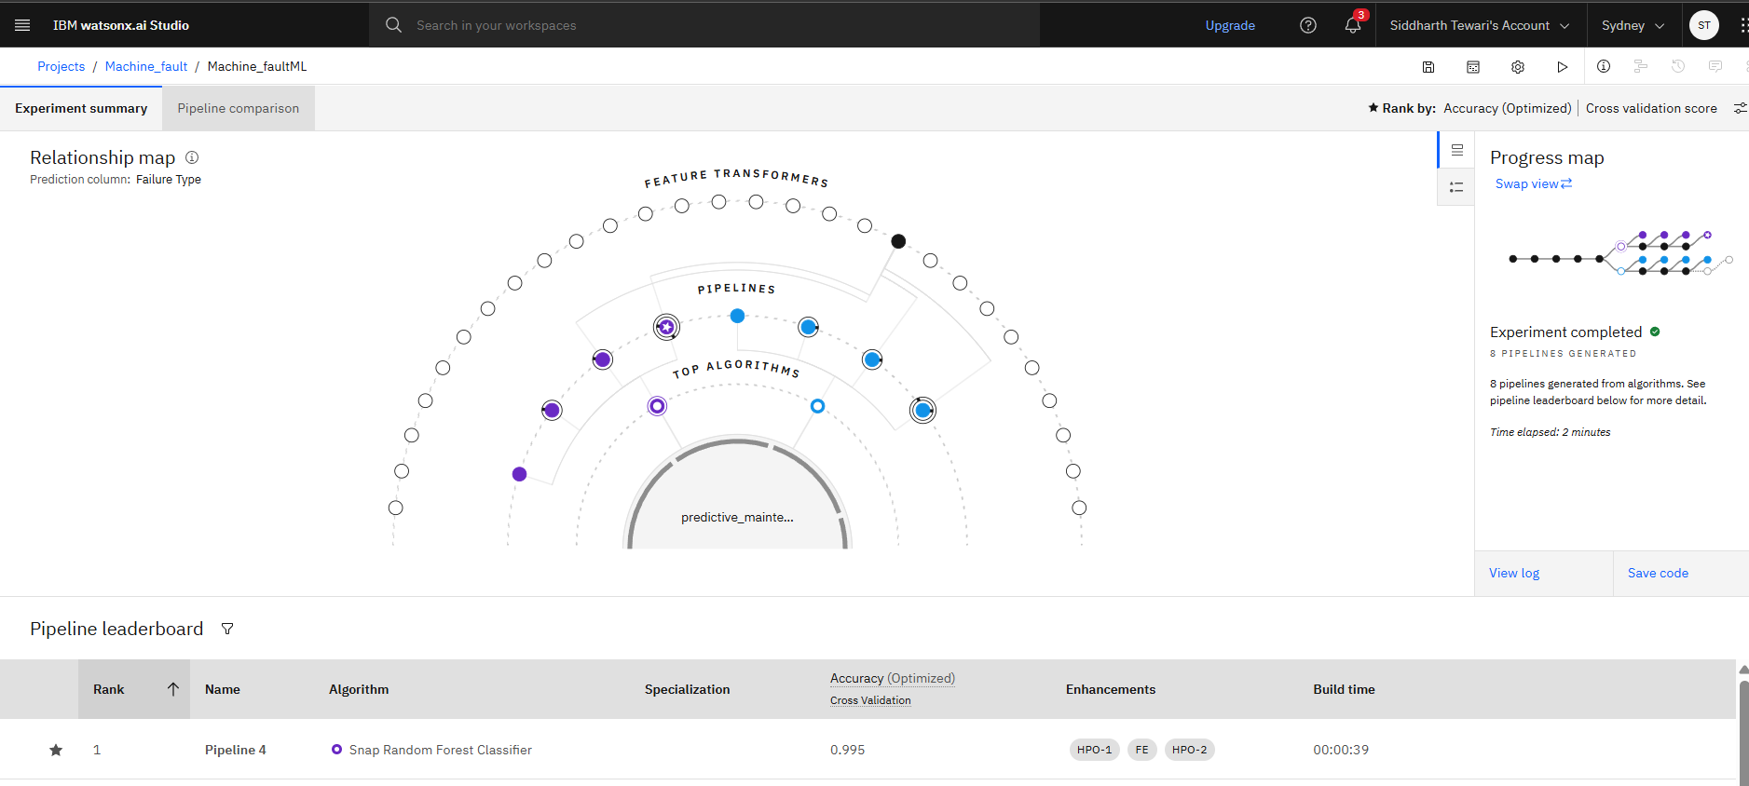
Result

Slide 8
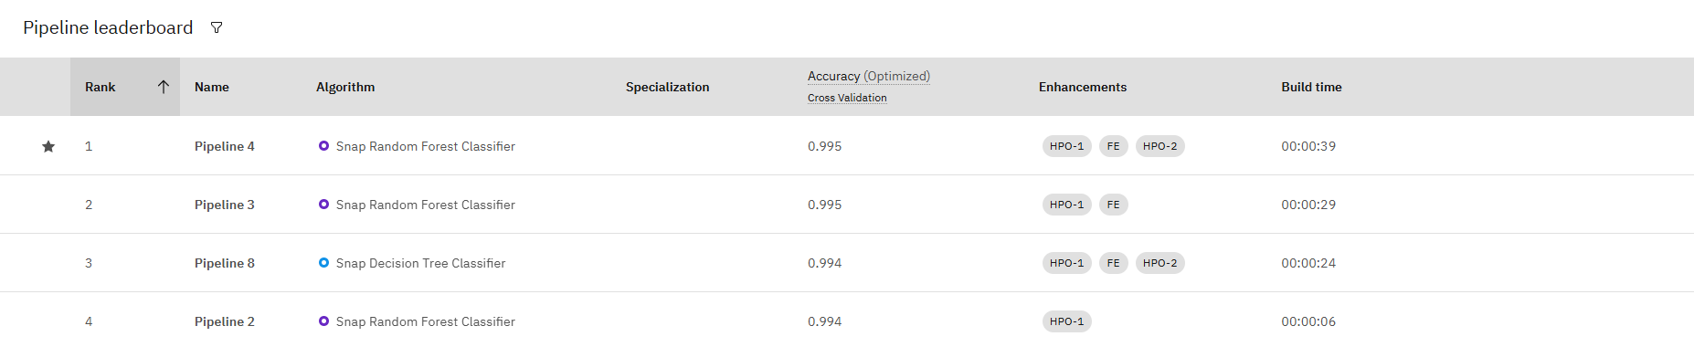
Result

Slide 9
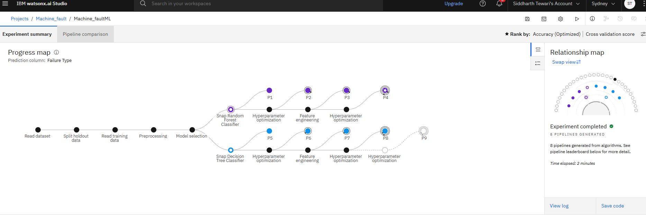
Result

Slide 10
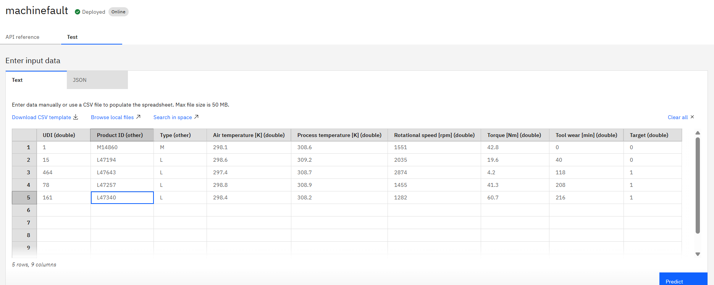
Result

Slide 11
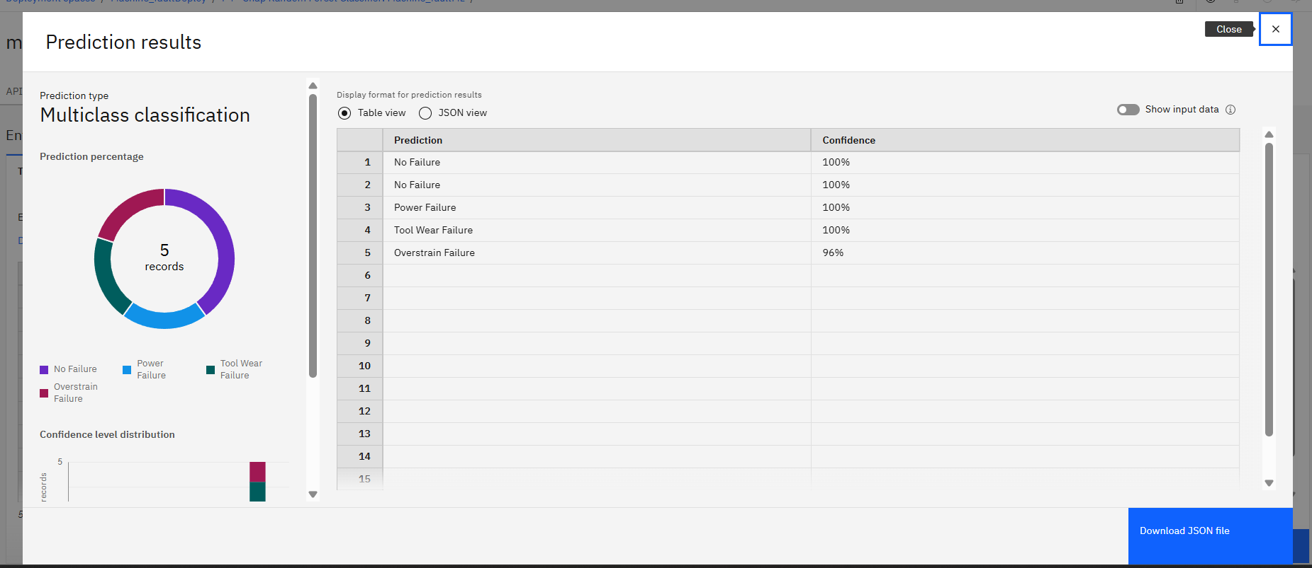
Result

Slide 12
Conclusion
Created a machine learning model that helps us to predict the type of failure (e.g., tool wear , heat dissipation, power failure) based on real-time operational data.
This machine learning model helps industrial machines to anticipate failures before they occur.

Slide 13
Future scope
Integration with IoT :
The convergence of ML with Internet of Things (IoT) devices enables real-time data collection from sensors embedded in machinery. Edge computing allows ML models to process data locally, reducing latency and bandwidth costs.
Cross-Industry Applications Scope :
Beyond traditional industries (manufacturing, energy), predictive maintenance will expand into healthcare (e.g., medical equipment), agriculture (e.g., farming machinery), and smart cities (e.g., infrastructure maintenance).

Slide 14
References
Kaggle dataset link(for predicting maintenance of industrial machinery) :
https://www.kaggle.com/datasets/shivamb/machine-predictive-maintenance-classification

Slide 15
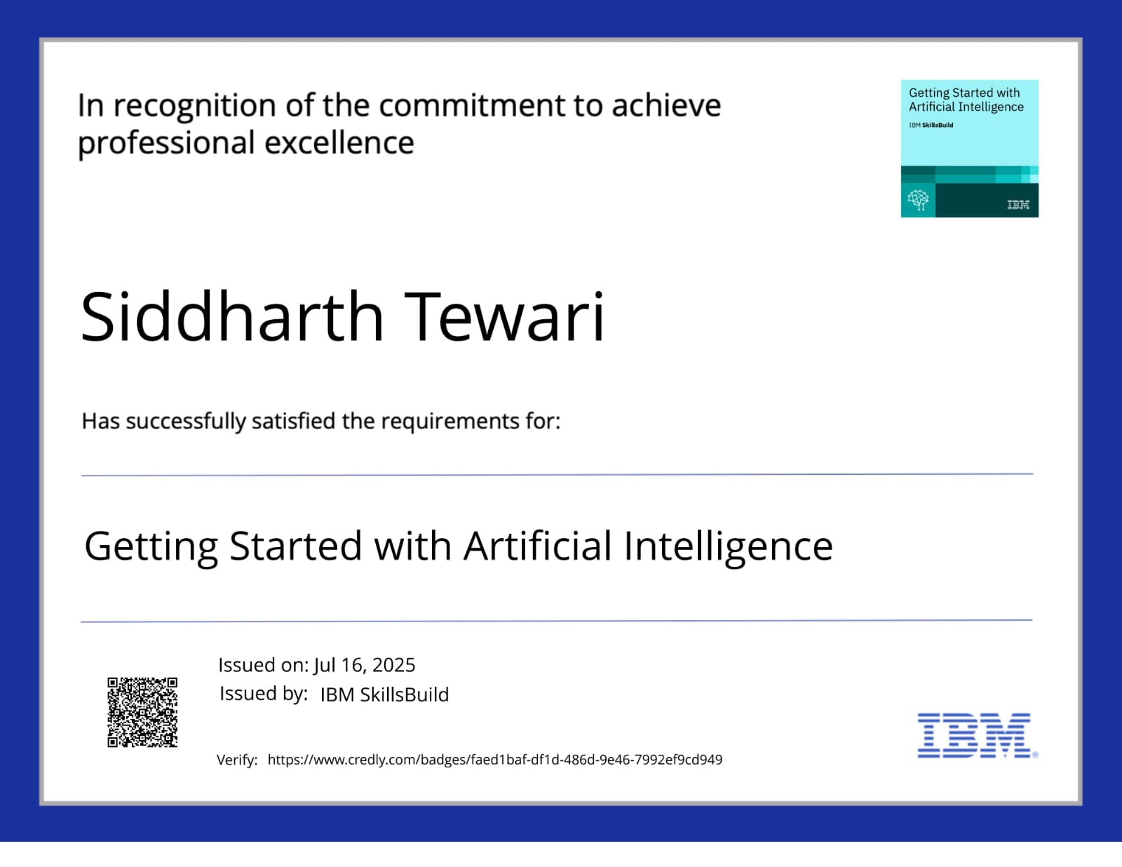
IBM Certifications

Slide 16
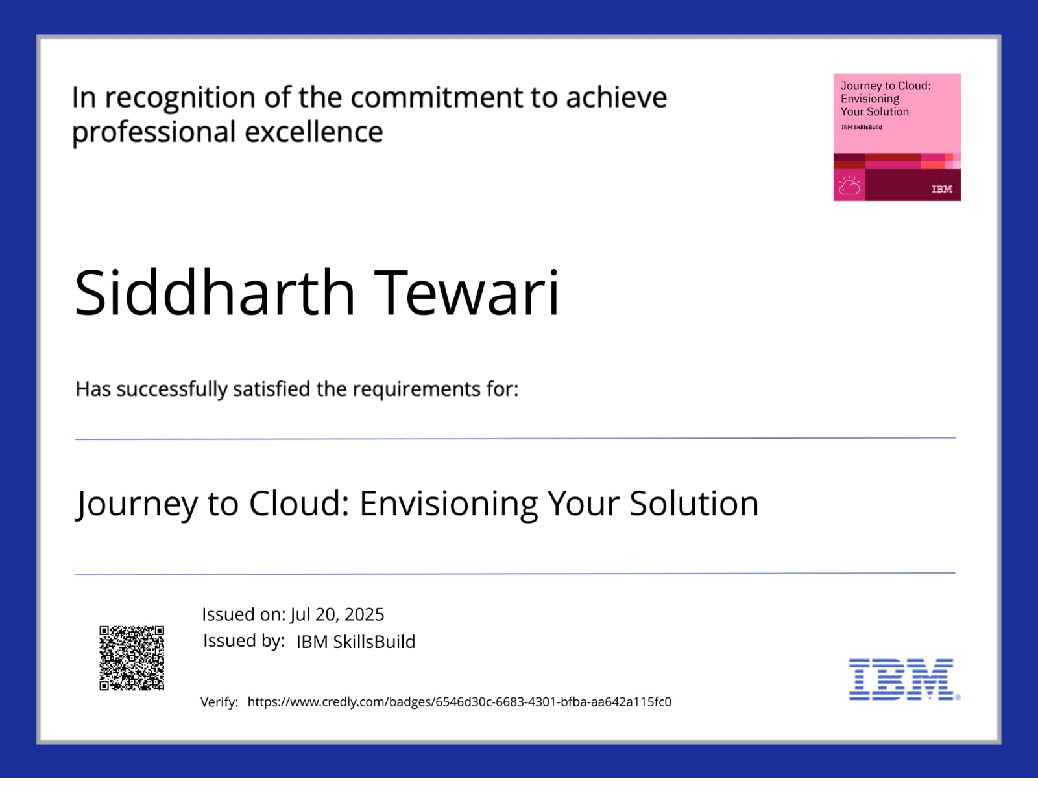
IBM Certifications

Slide 17
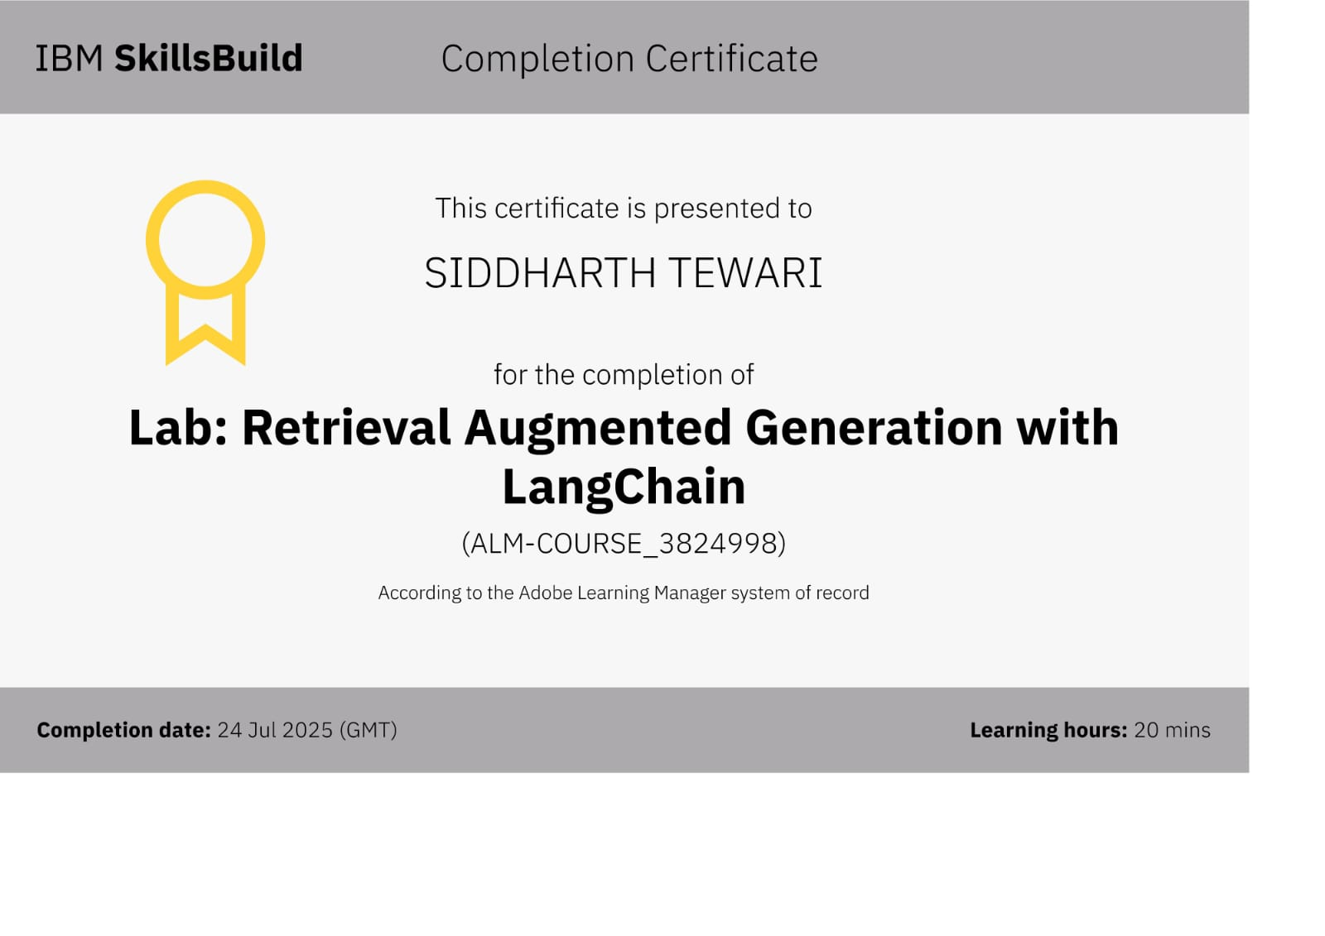
IBM Certifications

Slide 18
THANK YOU

